Slide 1
OBJECT-ORIENTED DESIGN & PROGRAMMING
Introduction to object-oriented design and programming technology (OOD/OOP). Main phases in object-oriented design and techniques in object-oriented programming. Programming language design and implementation issues for object-oriented languages.
(From “coder” to “programmer”)
Notes:
What is the difference between a coder and programmer?

Slide 2
General Overview
Concepts of Object-oriented programming
Review of Java programming
Concepts and diagrams of UML
All kinds of design patterns
Things to make you a better programmer and/or software designer.

Slide 3
Examples of UML and design patterns
https://www.uml-diagrams.org/index-examples.html
https://dzone.com/refcardz/design-patterns

Slide 4
Phases of software development
Specification and analysis
Design
Implementation
Maintenance
We will focus on the design and implementation phases

Slide 5
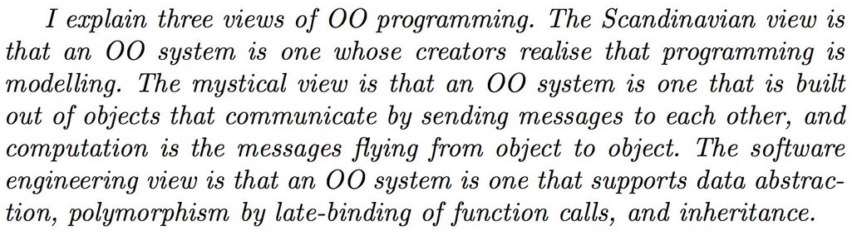
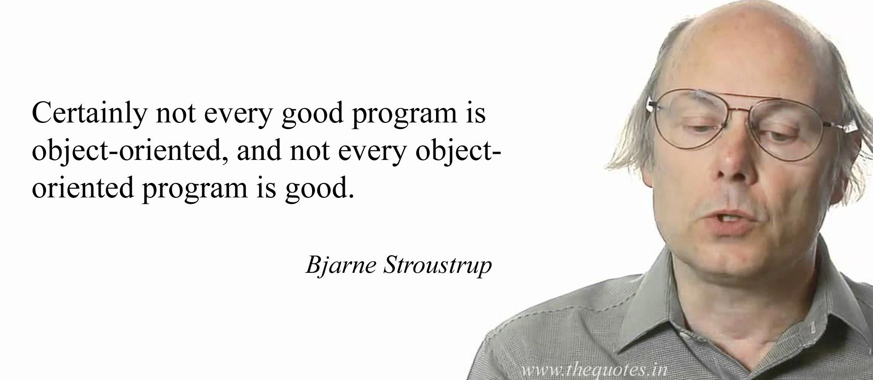
Quotes
The Myths of Object-Orientation, James Noble.
“Software is too important to be left to programmers”
Meilir Page-Jones
Never trust a "Software Engineer" who can't code.
Adam J. Conover
See: https://www.defprogramming.com/quotes-tagged-with/oop/

Slide 6
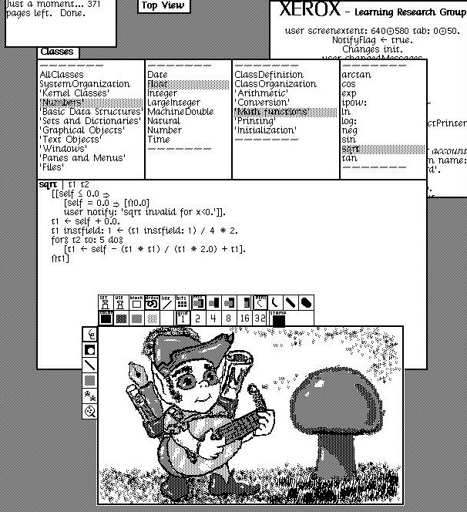
The “Mystical” View…
http://www.righto.com/2017/10/the-xerox-alto-smalltalk-and-rewriting.html

Slide 7
On the other hand... OOP allows for:
Code reuse
Unit Testing
Team programming
Encapsulation of data
Allows for data and operations on that data to be tightly coupled.
(“Functional Programmers” may argue that this is NOT a “Good Thing!”)
Development of libraries and frameworksparadigms
Software maintenance
Note: Other programming paradigms love for all of the above as well!

Slide 8
Programming Language Paradigms
Imperative (Procedural) Programming (C, Pascal)
Paradigm primarily based on the assignment of values to variables and data passed to functions/procedures.
Functional Programming (LISP/Scheme, SML, F#)
Paradigm based primarily on the use of “High order Functions.” Programs seen as one big composite function.
Object-Oriented Programming (C++, Java)
Paradigm based primarily on the passing of messages
Modern OOP incorporates elements of both procedureal and functional
Logic Programming (PROLOG, Erlang)
Paradigm based primarily on the declaration of needed facts and the use of automated deduction to derive results

Slide 9
The Development of Object-Oriented Programming

Slide 10
Simula
First OOP language in the 1960s
Developed by researchers at the Norwegian Computing Center for use in simulation
Introduced the foundational concept of “objects”
Its use as a general programming language was not at first realized

Slide 11
SmallTalk
Developed in 1970s at Xerox Parc
Based on idea of objects from Simula
Called SmallTalk because meant to be easy to use (i.e., easy enough for kids)
Its use as a general programming language was not at first realized
The fully further the concepts of OOP into what we know it today
Still an excellent language to learn OOP with

Slide 12

Alan Kay (developed SmallTalk)

Slide 13
C++
About the same time that SmallTalk was
being developed, C++ was being developed as
an OOP version of C at Bell Labs by Bjarne Stroustrup.
He also based the language on SmallTalk after hearing about it when doing his PhD at Cambridge University.

Slide 14

Bjarne Stroustrup (developed C++)

Slide 15
Java
Developed in early 1990s at Sun Microsystems
Originally developed for use in embedded systems
Saw its potential for use on the web
Is a general programming language, not just for web programming

Slide 16
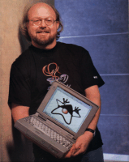
James Gosling (developed Java)

Slide 17
Use of OOP
First major conference on OOP and OOD held in 1986 – called OOPSLA for:
“Object-Oriented Programming Systems, Languages, and Applications”
The OOPSLA conference has since been renamed SPLASH.

Slide 18
Object-Oriented Programming

Slide 19
Objects are entities which have attributes and behavior. (This is the same as physical objects in the real world)
State is stored in what is called generically instance variables. Behavior is provided by what are called methods.

Slide 20
Fundamental Features of Object-Oriented Programming Languages
Encapsulation
What is encapsulation?
Inheritance
What it inheritance?
Polymorphism
What is polymorphism?

Slide 21
Overview of Object-Oriented Analysis and Design

Slide 22
Object-oriented programming became well known around 1981, when it appeared on the cover of Byte magazine
The 1980s was the decade of focus on object-oriented programming
The 1990s began focus on object-oriented approaches to object-oriented design

Slide 23
Early Design Methodologies

Slide 24
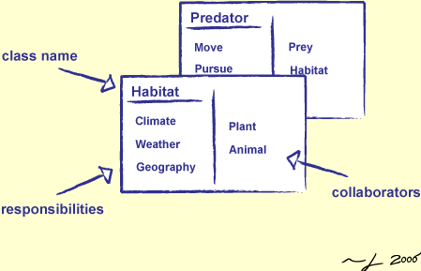
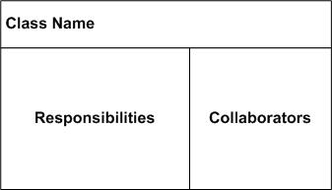
CRC Cards (1989)
Simple use of index cards, putting one class on each card. Helps limit the size of classes (what can fit on a card) and they associated.
Originally designed as a teaching tool but became more generally used.

Slide 25
Responsibility-Driven Design (RDD) (1990)
Views design as involving roles that entities play, in which each role has a specific set of responsibilities, for example,
information provider
coordinator
Roles are satisfied in implementation by objects, i.e., object implement responsibilities.

Slide 26
Applications as Responsibilities and Collaborations
Application = a set of interacting objects
Object = an implementation of one or more roles
Role = a set of related responsibilities
Responsibility = an obligation to perform a task or know information
Collaboration = an interaction of objects or roles (or both)
Contract = an agreement outlining the terms of a collaboration

Slide 27
User Point-of-View
Application involves information, services, and rules within a given domain.
Designer Point-of-View
Application involves roles (sets of responsibilities) and collaborations.
Implementer Point-of-View
Application involves the implementation of responsibilities and concern with application-specific objects (e.g., objects related to the user interface).

Slide 28
Roles vs. Objects
Roles and objects are the same when a given role is always played by the same object type.
When more than one kind of object can fulfill the same role, then a role is viewed as a set of responsibilities that can be fulfilled in more than one way.

Slide 29
Cohesion vs. Coupling

Slide 30
Two important aspects of a designed component are referred to as cohesion and coupling.
Cohesion refers to the degree to which the responsibilities of a given components are a meaningful unit. Greater cohesion reflects better design.
Coupling refers to the degree that one components must access directly access the data of another component. Less coupling reflects better design.

Slide 31
Refactoring

Slide 32
Refactoring is the process of improving the internal structure (both design and code) of software without altering its external behavior.
IDEs (like NetBeans, IntelliJ IDEA, Eclipse, etc.) usually have some built-in
refactoring tools.

Slide 33
Other Design Methodologies
(early 1990s)

Slide 34
James Rumbaugh, Ivar Jacobson, and Grady Booch (who created the Rational Company, now a part of IBM) each developed their own, widely known, object-oriented design methodologies.
Would go on to be very influential in OOD.

Slide 35
Object-Oriented Analysis
Object-oriented analysis is a means of deter-mining what aspects of a given problem can be viewed as objects in an eventual object-oriented design.
Thus,
OOA (object-oriented analysis)
OOD (object-oriented design)
OOP (object-oriented programming)

Slide 36
EXAMPLE: FedEx System
For example, suppose we were to develop an overall software system to be used by FedEx.
The business model would involve things like how package shipments are charged, what their costs are, how their profits are determined, etc.
The domain model would identify what entities there are (physical or conceptual) in the system, things like packages, delivery trucks, customer accounts, etc.

Slide 37
Overview of the Unified Modeling Language (UML)

Slide 38
In 1980’s more and more organizations started using OOP.
There was a need for a standardized methodology of OOD.
By early 1990s, different companies using different notations (even within the same company).
A better solution was needed!

Slide 39
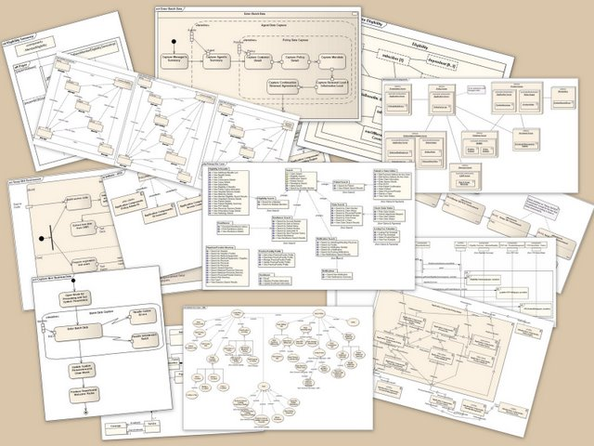
UML

Slide 40
Grady Booch, James Rumbaugh, and Ivar Jacobson developing own graphical design languages
In 1994, James Rumbaugh joined Grady Booch at Rational, and soon after, Ivar Jacobson joined them also.
In 1996, the group released an early version of the Unified Modeling Language (UML).

Slide 41
About the same time, and organization called the Object Management Group (OMG) invited submissions for a common modeling and specification language.
OMG is a not-for-profit organization issuing guidelines and specifications for object-oriented technologies, including IBM, HP, Microsoft, and Rational Software.
IBM, HP, Microsoft, and Rational formed a group called UML Partners in response to the modeling language request from OMG.

Slide 42
UML version 1.1 was developed and submitted to OMG. It was accepted, and in 1997, took responsibility for the ongoing maintenance and revisions of UML.
UML 2.0 released in 2002.
UML specification has been accepted as a ISO (international standard) specification.
UML is the first specification language to ever become standardized.

Slide 43
Software Components, Frameworks and Design Patterns

Slide 44
Reuse is an integral aspect of software design.
Software components, frameworks and design patterns represent three forms of reuse.

Slide 45
Software Components (reuse of code)
Involves the modification and reuse of executable code, just as dragging and modifying button in creating a GUI in visual programming environment. (Java’s version of this is called a JavaBean)
Frameworks (reuse of “plug-in” code)
A partial implementation that must be completed. Analogous to a motherboard and its hardware components.
Design Patterns (reuse of design)
A design patterns is a commonly occurring collection of classes and their collaborations that is identified and named, providing for a reusable design approach that others can adopt.

Slide 46
Design Patterns

Slide 47
The concepts of design patterns in software design came from the use of such patterns in architecture.
“Design Patterns: Elements of Reusable Object-Oriented Software” (by Gamma, Helm, Johnson, and Vlissides, Addison-Wesley, 1995)

Slide 48
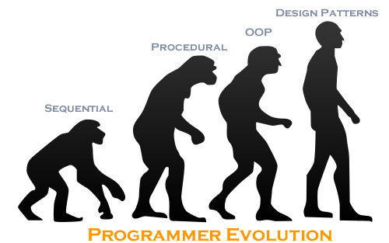

Slide 49
Example Design Pattern
How to design a class so that only one object instance of that class is created?
Singleton Design Pattern is an elegant solution to this problem.
(Why would we want to guarantee that only ONE instance of any class existed at any given time?)

Slide 50
Object-Oriented Development Methodologies
“Waterfall Model”
Requirements Analysis
Specification
Design
Implementation
Testing
Goal is to do each step perfectly before the next step so that a prior step is never repeated. Not a realistic approach.

Slide 51
Agile Development Methodologies
Changes are expected
Development approach accommodates changes
Object-oriented design
Frequent iterations of design
“Evolving Designs”
This works well in the object-oriented paradigm.

Slide 52
Extreme Programming (“lightweight” agile development)
A “lightweight” agile development process
More focused on coding than on design
Each iteration very short (few days – few weeks)
Each iteration focused on
refactoring (factoring out common code)
enhancements (new functionality or features)

Slide 53
Key Principles of Extreme Programming
Simple initial plan that continually gets refined
Frequent and small releases
Each release no more than a few weeks apart
Develop a vocabulary for communicating with client
Make design as simple as possible.
Test first – unit test before writing code.
Refactoring – refactor to continually make system simpler
Pair programming – write all production code in pairs
Anyone may change code anywhere in system to improve
Integrate as soon as task is complete
Teams should stay fresh and work no more than 40 hours
Should have customer on site, full time.
Adopt common standards and conventions for source code, documentation, etc.

Slide 54
The Expense of Software Development

Slide 55


Cost!
The cost of purchasing, developing, maintaining, and updated software has become the largest expense for many companies.
The aim of the object-oriented software development methodologies is to significantly improve the practice of software development

Slide 56
“Elegant” Software design?

Slide 57


Usability Is the software easy to use?

Slide 58
Completeness Does it satisfy all the client’s needs?

Slide 59
Robustness Does it deal with unexpected situations gracefully and avoid crashing?

Slide 60
Efficiency Does it perform the necessary computations in a reasonable amount of time using a reasonable amount of memory and other resources?

Slide 61
Scalability Will it still perform correctly when the problems grow in size by orders of magnitude?

Slide 62
Readability Is it easy for other to understand the software design and coding?

Slide 63
Reusability Can the software be used in another completely different setting?

Slide 64
Simplicity Is the design and/or implementation unnecessarily complex?

Slide 65
Maintainability Can defects be found and fixed easily without adding new defects?

Slide 66
Extensibility Can the software be enhanced or restricted by adding new features or removing old features without “breaking” the code?

Slide 67
Why Worry about Software Design?
It is inevitable that large software systems will have bugs.
These bugs can be just annoying, or they can be catastrophic.

Slide 68
Examples of Software Failures
In 1962, the Mariner I spacecraft was accidentally destroyed.
In 1980’s, patients were given massive overdoes of radiation.
In 1990’s, a 9-hour nationwide phone blockage occurred.
In 2000’s, cash machines dispensed cash freely.

Slide 69
Radiation machine for treating cancer patients.
Eventually, bug found after entering and clearing the dose of radiation in a certain sequence – administered an extremely large dose, even though it was clear and corrected in the display.
Woman lost use of her arm.

Slide 70

Famous incident in 1990. AT&T long-distance network went down for over 8 hours for the whole US. (cause: missing break statement)
There was a simple change made to the software.
The change involved inserting a single break statement in the wrong place.

Slide 71


Scale of Software Bug Problems
Software quality issues are estimated to cost the US economy over $2 TRILLION dollars annually!!!
https://raygun.com/blog/cost-of-software-errors/
Software developers spend 80% of their development time finding and fixing bugs

Slide 72
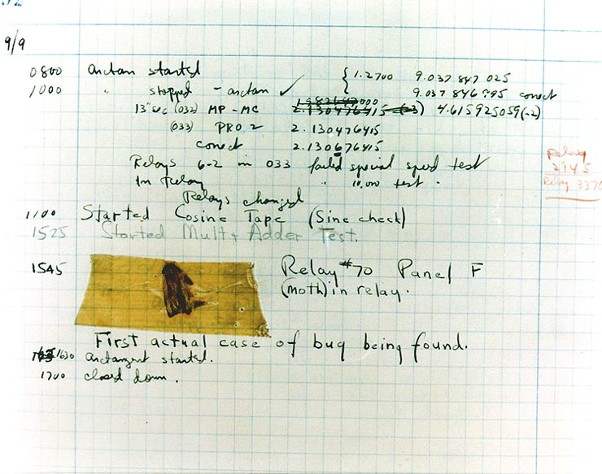
The First Software “Bug” (September 9th, 1945 in Mark II at Harvard)

Slide 73
Goal of Elegant Software Design:
Minimize the number of initial bugs created
Maximize the detection and removal of any bugs
Minimize the number of new bugs added during modification

Slide 74
Forces Working against Bug-free Software
Doing a job right takes time and money, but software developers are under pressure to complete projects quickly
Writing high quality software requires skill, knowledge and experience that many people do not have

Slide 75
Criteria for “Elegant” Software
Usability
Completeness
Robustness
Efficiency
Scalability
Readability
Reusability
Simplicity
Maintainability
Extensibility

